Slide 1
Chem 108: Lab
Week 10
Sign in
Pick up graded papers
Sit at Lab Drawer Station
Notes:
A 3900-year-old clay tablet, which was found in Iraq between the Tigris and Euphrates rivers, had a Sumerian poem (http://www.piney.com/BabNinkasi.html) honoring Ninkasi, the patron goddess of brewing. It contains the oldest surviving beer recipe, describing the fermentation of the carbohydrates found in bread, bappir, made from barley, honey, dates and sweet aromatic herbs. The global availability of carbohydrates and native microbes (yeasts) has led to the production of many different types of beers, ales, wines, and fruit based alcoholic beverages in many countries throughout the world. [The bottle on the left was found in Eugene, Oregon, ……. But, it dates only to 2016.]

Slide 2
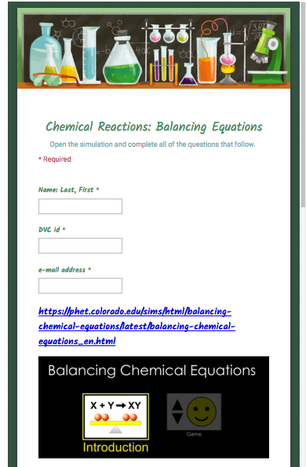
Chemical Reactions
Laboratory Manual: Report Form
pp.46-52 DUE Today
Post Lab (Individually Submitted): On-line Balancing Equations DUE Friday
Notes:
A 3900-year-old clay tablet, which was found in Iraq between the Tigris and Euphrates rivers, had a Sumerian poem (http://www.piney.com/BabNinkasi.html) honoring Ninkasi, the patron goddess of brewing. It contains the oldest surviving beer recipe, describing the fermentation of the carbohydrates found in bread, bappir, made from barley, honey, dates and sweet aromatic herbs. The global availability of carbohydrates and native microbes (yeasts) has led to the production of many different types of beers, ales, wines, and fruit based alcoholic beverages in many countries throughout the world. [The bottle on the left was found in Eugene, Oregon, ……. But, it dates only to 2016.]

Slide 3
Exam #2:
Content is through Chemical Reactions, Stoichiometry, Net Ionic Equations, and focuses on all topics since Exam 1

Slide 4
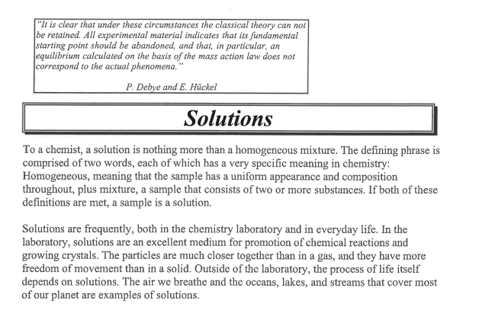
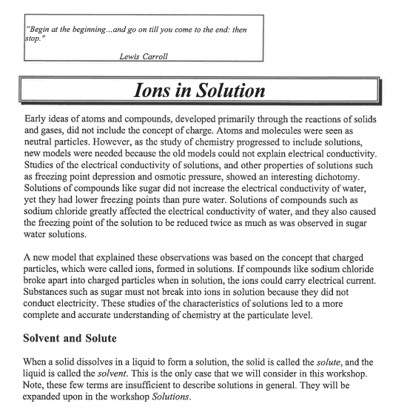
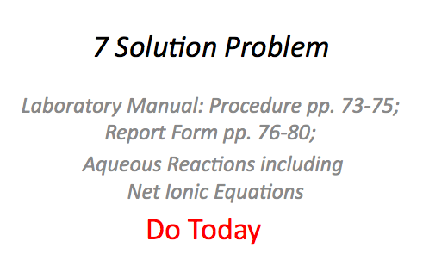

Slide 5
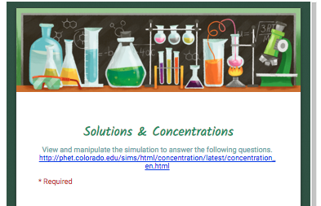
Exam #2: Monday November 2nd
Includes (GQ) Solutions & Concentrations Guiding Questions
PhET: Concentration / Calculations
Guiding Questions
http://chemconnections.org/general/chem108/Solutions%20Guide.html

Slide 6
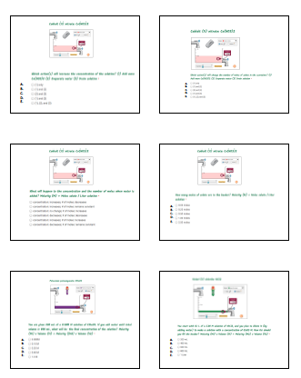
Complete Guiding Questions & Submit before Exam 2
Qualitative & Quantitative Questions dealing with 3 different solutions, Molarity (M), & its applications.
Focus on first 4 questions for Exam 2.
Understand what is a solvent and a solute; plus Molarity (M)
http://chemconnections.org/general/chem108/Solutions%20Guide.html

Slide 7
Aqueous Reactions
(Solutions/ Molarity)
Net Ionic Equations
Dr. Ron Rusay

Slide 8
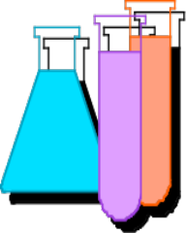
Aqueous Reactions & Solutions
Many reactions are done in a homogeneous liquid or gas phase which generally improves reaction rates.
The prime medium for many inorganic reactions is water, which serves as a solvent (the substance present in the larger amount), but does not react itself.
The substance(s) dissolved in the solvent is (are) the solute(s). Together they comprise a solution. The reactants would be the solutes.
Reaction solutions typically have less solute dissolved than is possible and are “unsaturated”.

Slide 9

Aqueous Reactions
There are a few general types:
1) Precipitation: An insoluble salt forms from the addition of solutions. (Cloudiness is oberved. Solubility governs):
(aq) (s)
2) Acid-Base (Neutralization): generally produces a salt, plus heat + water (l):
(aq) (l)
3) Oxidation-Reduction (Redox): there is a change in oxidation numbers between reactants and products

Slide 10
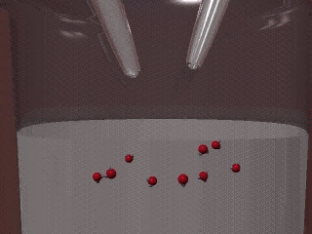
Aqueous Reactions: Neutralization

Slide 11
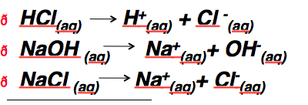
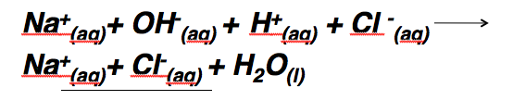
Aqueous Reactions: Neutralization
Net Ionic Equations
HCl_{(aq)} + NaOH _{(aq)} NaCl _{(aq)} + H₂O_{(l)}
H⁺_{(aq)} + OH ⁻_{(aq)} H₂O_{(l)}

Slide 12
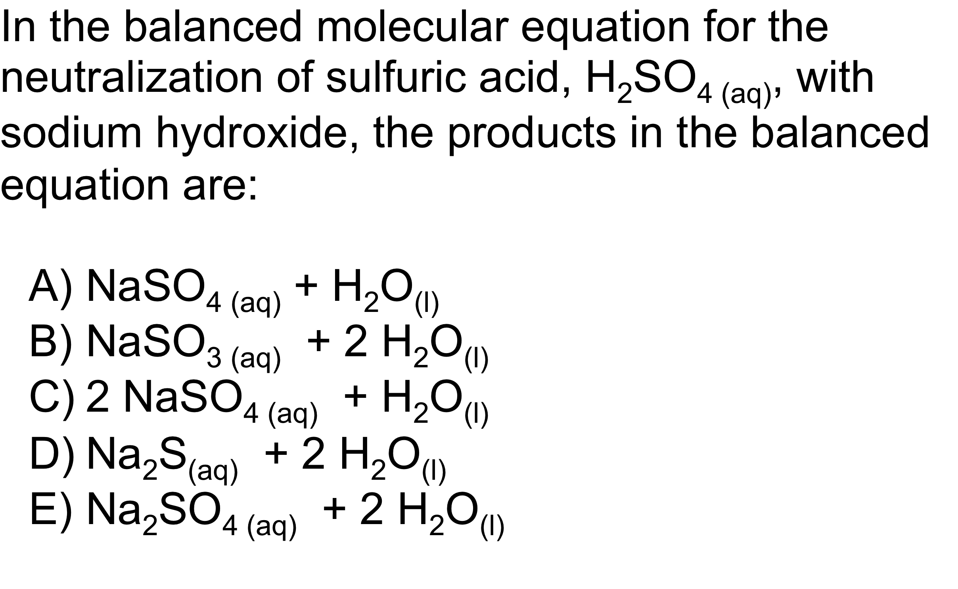
QUESTION

Slide 13

Answer
H₂SO₄ (aq) + NaOH (aq)
2
HNO₃ (aq) + NaOH (aq) NaNO₃ (aq) + H₂O (l)
1
How many moles of sodium hydroxide will it take to completely neutralize 1 mole of sulfuric acid H₂SO₄?
….to neutralize 1 mole of nitric acid HNO₃?

Slide 14
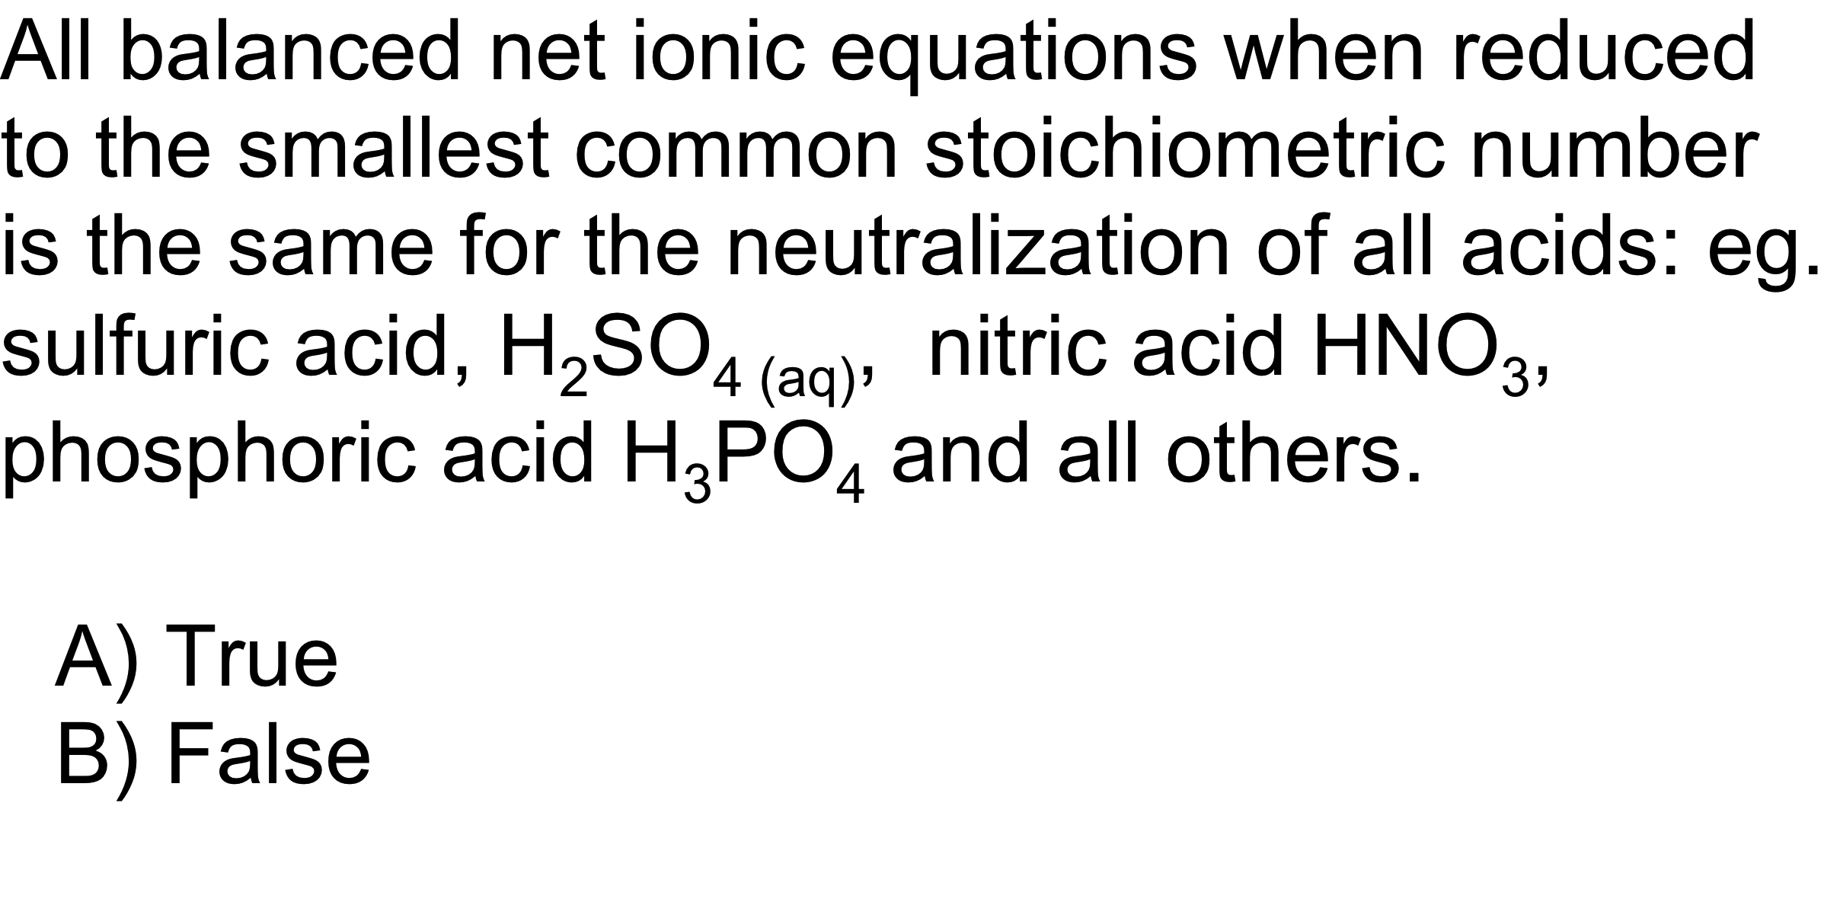
QUESTION
x H⁺_{(aq)} + x OH ⁻_{(aq)} x H₂O_{(l)}

Slide 15
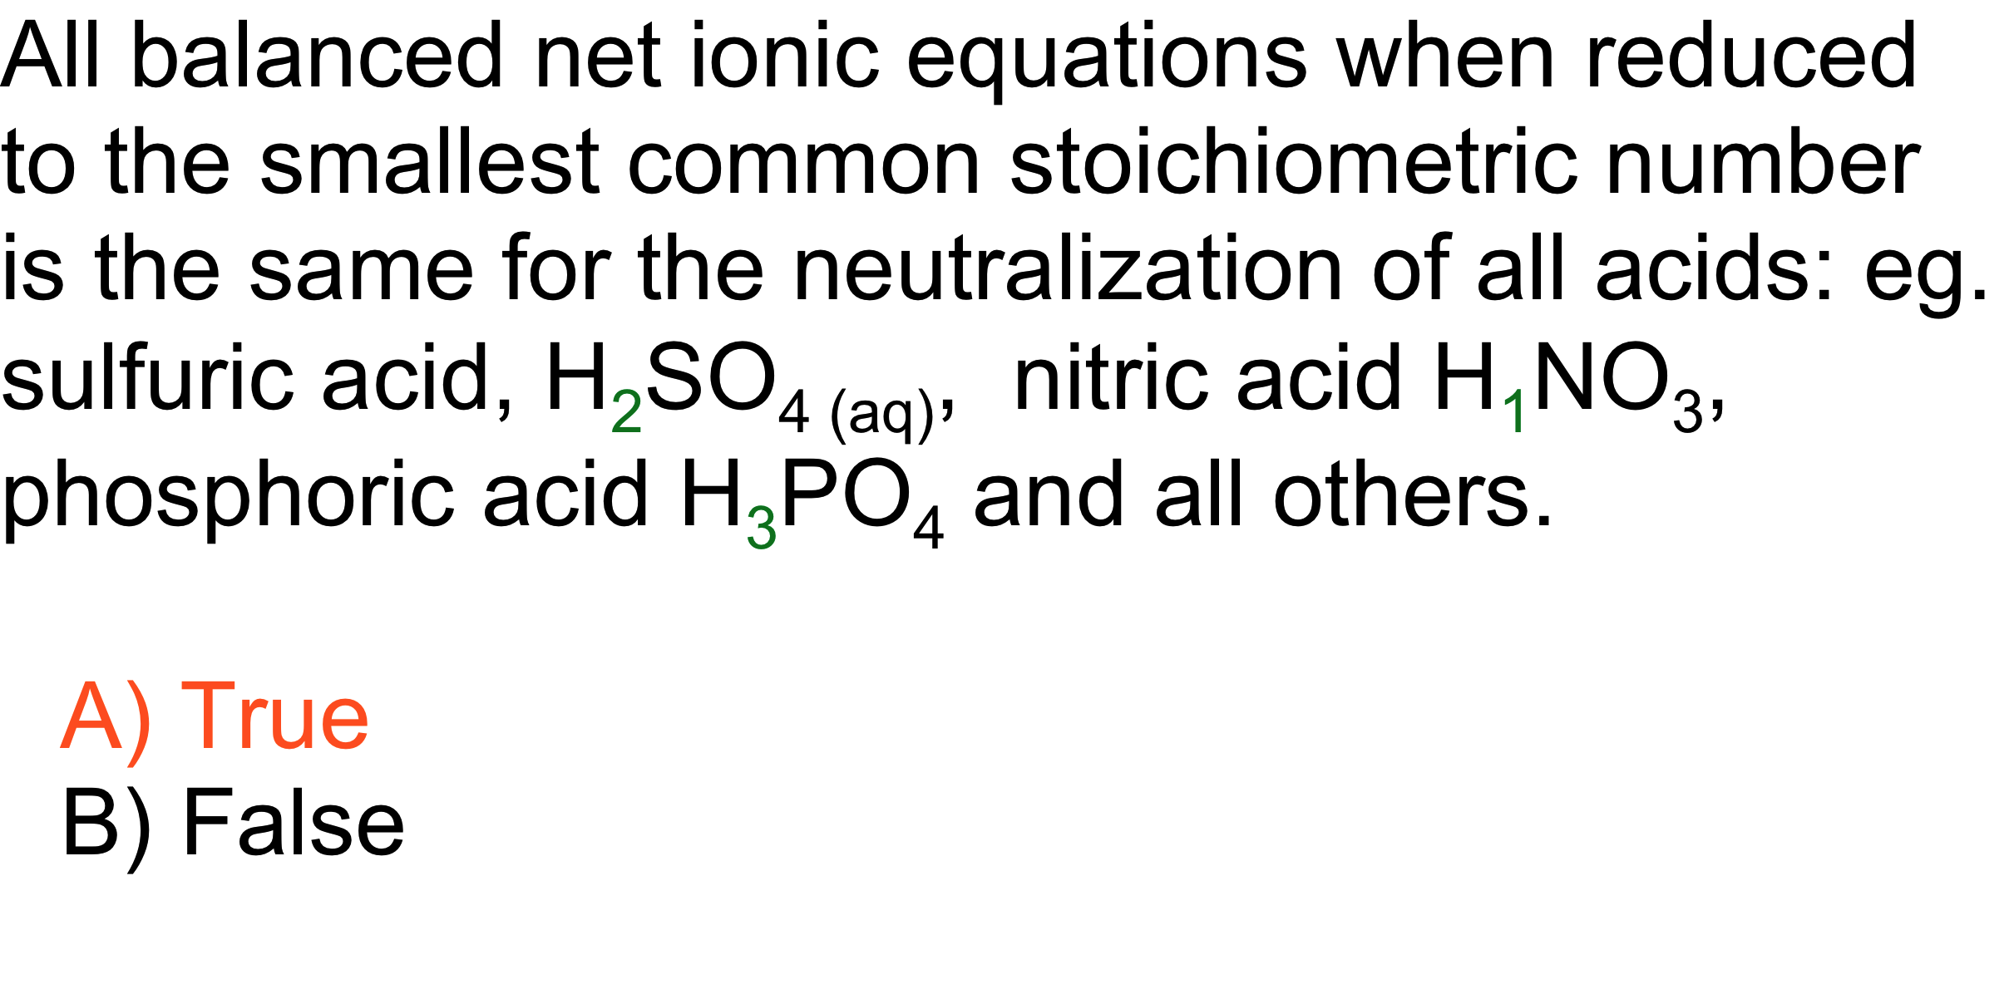
Answer
x H⁺_{(aq)} + x OH ⁻_{(aq)} x H₂O_{(l)}

Slide 16
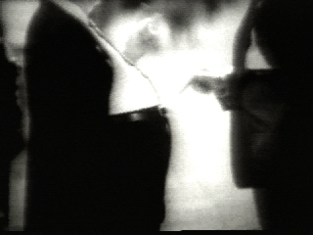
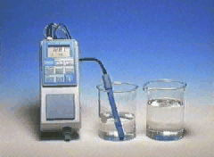
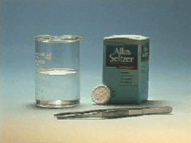
Aqueous Reactions: Acid-Base

Slide 17
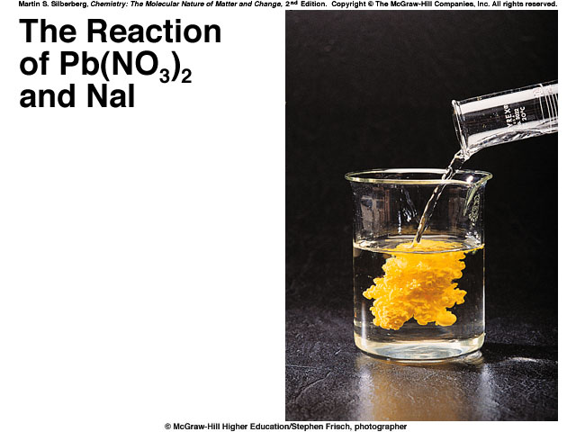
What type of reaction is it?
Double Displacement & Precipitation
Write a balanced equation for the reaction.
Pb(NO₃)₂ (aq) + NaI (aq) →
2
2
NaNO₃(aq) + PbI ₂(s)
How do you know the state of the products: (s) vs. (aq)?

Slide 18
What type of reaction is it?
Double Displacement & Precipitation
Write a balanced equation for the reaction.
Pb(NO₃)₂ (aq) + NaI (aq) →
2
2
NaNO₃(aq) + PbI ₂(s)
How do you know the state of the products: (s) and (aq)?

Slide 19
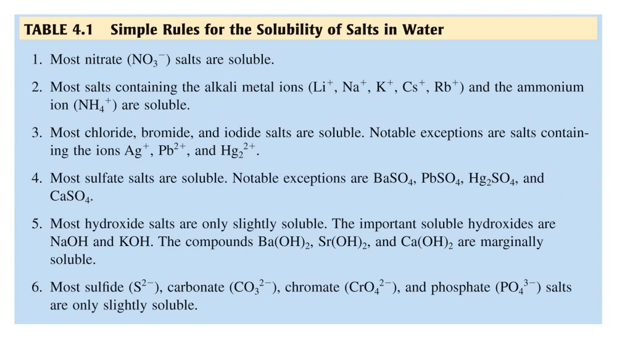
Precipitation Reactions: Solubility Tables
(aq) soluble versus (s) insoluble

Slide 20
Double Displacement & Precipitation
Pb(NO₃)₂ (aq) + NaI (aq) →
2
2
NaNO₃(aq) + PbI ₂(s)
Net Ionic Equation (NIE) & state of the products:
(aq) versus (s)
Pb²⁺ (aq) + 2 I⁻ (aq) → PbI ₂(s)

Slide 21
Pb(NO₃)₂ (aq) + NaI (aq) →
2
2
NaNO₃(aq) + PbI ₂(s)
Balanced Net Ionic equation for the reaction.
Pb ²⁺ ⁽aq) + 2 I ¹⁻ (aq) → PbI ₂(s)
What are the spectator ions in the reaction?
2 Na ¹⁺ ⁽aq); 2 NO₃¹⁻ (aq)

Slide 22
QUESTION
Given the insoluble compound Al₂(CO₃)₃(s) predict the ions and coefficients that would be necessary to complete the following net ionic equation:
__ _____ + __ _____ → Al₂(CO₃)₃ (s)
2 AlCl₃(aq) + 3 Na₂CO₃(aq) also include 6 NaCl(aq) on right
3 Al³⁺(aq) + 2 CO₃^{2–}(aq)
2 Al³⁺(aq) + 3 CO₃^{2–}(aq)
2 Al³⁺(aq) + 6 Cl –(aq) + 3 CO₃^{2–}(aq) + 6 Na⁺(aq)

Slide 23
ANSWER
Given the insoluble compound Al₂(CO₃)₃ predict the ions and coefficients that would be necessary to complete the following net ionic equation:
__ _____ + __ _____ → Al₂(CO₃)₃ (s)
2 AlCl₃(aq) + 3 Na₂CO₃(aq) also include 6 NaCl(aq) on right
3 Al³⁺(aq) + 2 CO₃^{2–}(aq)
2 Al³⁺(aq) + 3 CO₃^{2–}(aq)
2 Al³⁺(aq) + 6 Cl –(aq) + 3 CO₃^{2–}(aq) + 6 Na⁺(aq)

Slide 24
7 Solution Problem
Laboratory Manual: Procedure pp. 73-75; Report Form pp. 76-80;
Aqueous Reactions including
Net Ionic Equations
To Do Today

Slide 25
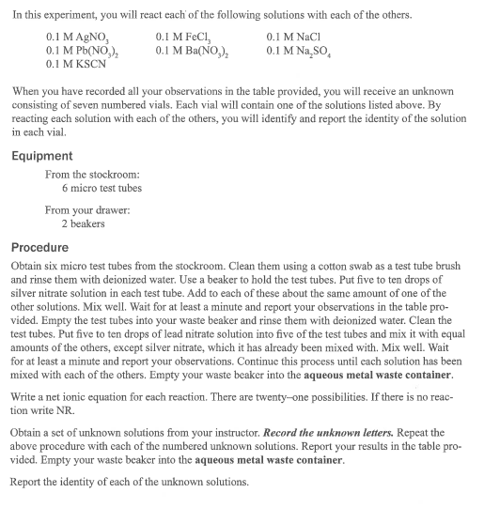
7 Solution Problem
To Do Today
Notes:
A 3900-year-old clay tablet, which was found in Iraq between the Tigris and Euphrates rivers, had a Sumerian poem (http://www.piney.com/BabNinkasi.html) honoring Ninkasi, the patron goddess of brewing. It contains the oldest surviving beer recipe, describing the fermentation of the carbohydrates found in bread, bappir, made from barley, honey, dates and sweet aromatic herbs. The global availability of carbohydrates and native microbes (yeasts) has led to the production of many different types of beers, ales, wines, and fruit based alcoholic beverages in many countries throughout the world. [The bottle on the left was found in Eugene, Oregon, ……. But, it dates only to 2016.]

Slide 26
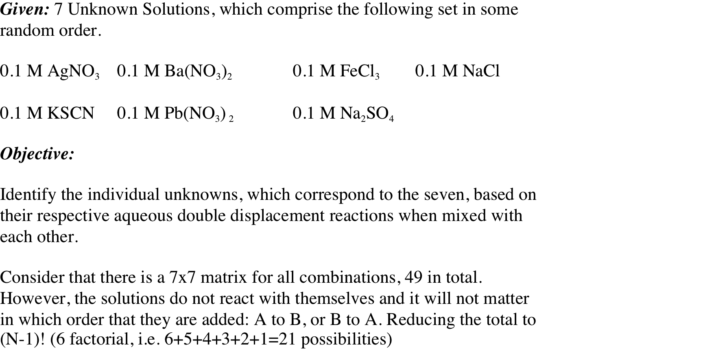
7 Solution Problem

Slide 27
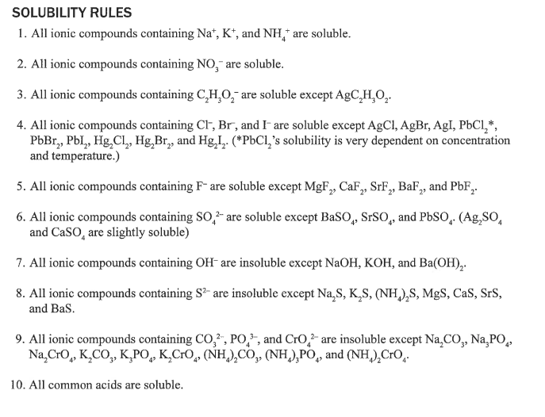
Do Today

Slide 28
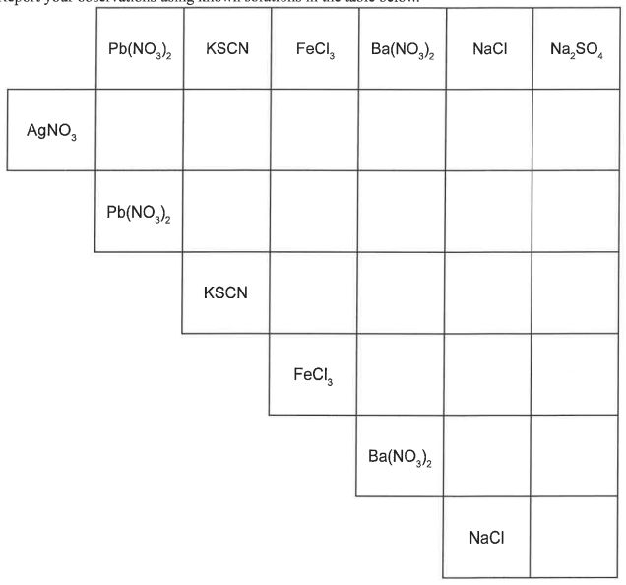
Develop an Empirical Data Template for Knowns
(Working with a partner complete pg. 76)
0.1 M AgNO₃ 0.1 M Ba(NO₃)₂ 0.1 M NaCl 0.1 M KSCN
0.1 M FeCl₃ 0.1 M Na₂SO₄ 0.1 M Pb(NO₃) ₂
Mix solutions and predict the result for: AgNO₃(aq) + Ba(NO₃)₂(aq)

Slide 29
AgNO₃(aq) + Ba(NO₃)₂(aq) →
AgNO₃(aq) + Ba(NO₃)₂(aq) → Nothing Observed
__________________________
Double Displacement Equation:
AgNO₃(aq) + Ba(NO₃)₂(aq) → Ba(NO₃)₂(aq) + Ag(NO₃)(aq)
Net Ionic Equation:
Ag⁺(aq) + NO₃⁻(aq) + Ba²⁺(aq) + 2 (NO₃⁻)₂(aq) →
Ba²⁺(aq) + 2 (NO₃⁻)₂(aq) + Ag⁺(aq) + NO₃⁻(aq)
No Reaction / NR

Slide 30
Develop an Empirical Data Template for Knowns
(Working with a partner complete pg. 76)
0.1 M AgNO₃ 0.1 M Ba(NO₃)₂ 0.1 M NaCl 0.1 M KSCN
0.1 M FeCl₃ 0.1 M Na₂SO₄ 0.1 M Pb(NO₃) ₂
No
Rxn
Mix solutions and predict the result for: AgNO₃(aq) + Ba(NO₃)₂(aq)

Slide 31
Develop an Empirical Data Template for Knowns
(Working with a partner complete pg. 76)
0.1 M AgNO₃ 0.1 M Ba(NO₃)₂ 0.1 M NaCl 0.1 M KSCN
0.1 M FeCl₃ 0.1 M Na₂SO₄ 0.1 M Pb(NO₃) ₂
No
Rxn
Mix solutions and predict the result for: AgNO₃(aq) + NaCl(aq)

Slide 32
AgNO₃(aq) + NaCl(aq) →
[White Precipitate: ppt]
Double Displacement Equation:
AgNO₃(aq) + NaCl(aq) → AgCl(?) + NaNO₃ (?)
AgNO₃(aq) + NaCl(aq) → AgCl(s) + NaNO₃ (aq)
________________________
Net Ionic Equation:
Ag⁺(aq) + Cl⁻(aq) → AgCl(s)

Slide 33
Develop an Empirical Data Template for Knowns
(Working with a partner complete pg. 76)
0.1 M AgNO₃ 0.1 M Ba(NO₃)₂ 0.1 M NaCl 0.1 M KSCN
0.1 M FeCl₃ 0.1 M Na₂SO₄ 0.1 M Pb(NO₃) ₂
No
Rxn
White
ppt
Mix solutions and predict the result for: AgNO₃(aq) + NaCl(aq)

Slide 34
Develop an Empirical Data Template for Knowns
(Working with a partner complete pg. 76)
0.1 M AgNO₃ 0.1 M Ba(NO₃)₂ 0.1 M NaCl 0.1 M KSCN
0.1 M FeCl₃ 0.1 M Na₂SO₄ 0.1 M Pb(NO₃) ₂
No
Rxn
White
ppt
Mix solutions and predict the result for: AgNO₃(aq) + NaCl(aq)
(Everyone is to show Dr. R. their individual table, pg. 76, & get an individual unknown. Every partner will do their own individual unknown)

Slide 35
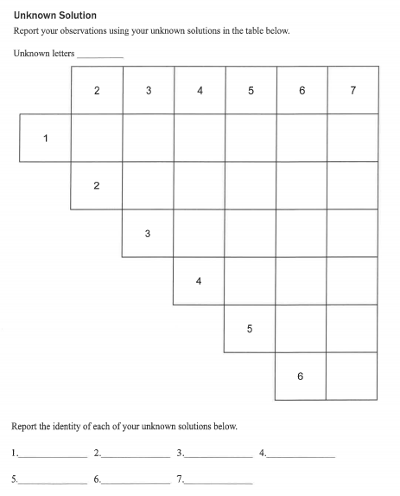
Complete reactions with unknown, then compare Individual Unknown results to
Known results to identify the 7 solutions
0.1 M AgNO₃ 0.1 M Ba(NO₃)₂ 0.1 M NaCl 0.1 M KSCN
0.1 M FeCl₃ 0.1 M Na₂SO₄ 0.1 M Pb(NO₃) ₂
(Show Dr.R. completed table,
pg.80, before leaving lab.)

Slide 36
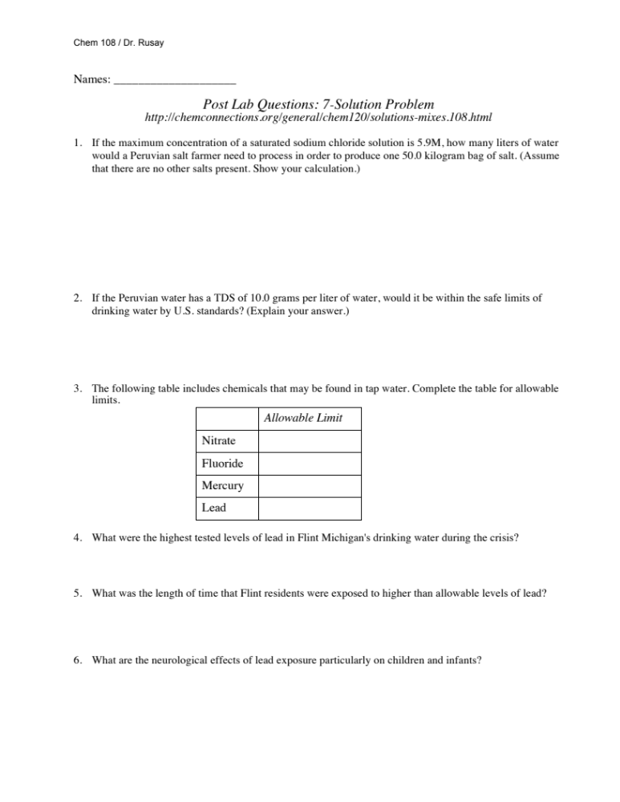
Post Lab Questions
Due Next Week with Report pp. 76-80
(Show Dr.R. the completed known table to get an individual unknown.)

